Slide 1
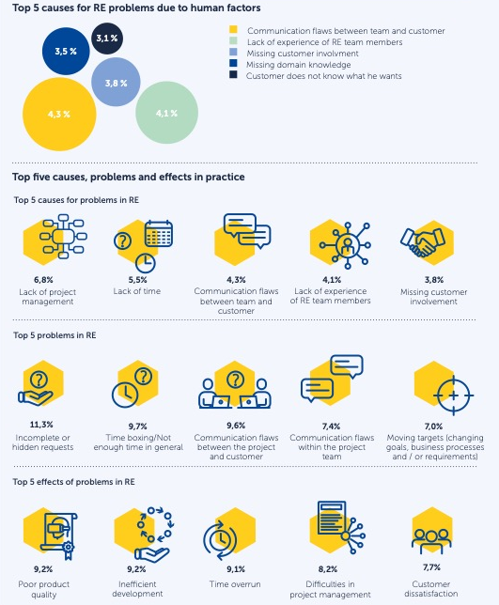
Naming the Pain in Requirements Engineering
A globally distributed, bi-yearly family of surveys on the status quo and challenges in Requirements Engineering
More on: www.napire.org

Slide 2
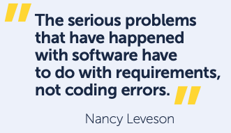

Naming the Pain in Requirements Engineering
A globally distributed, bi-yearly family of surveys on the status quo and challenges in Requirements Engineering
👉 What is NaPiRE?
Survey running until April 30, 2025
Naming the Pain in Requirements Engineering (“NaPiRE”) is an initiative by the international community of Software Engineering researchers, launched in 2012. As part of that initiative, we regularly conduct systematic online surveys to explore contemporary practices and challenges in Requirements Engineering.
👉 Why is it important?
By better understanding how practitioners handle requirements and what problems they encounter – by better understanding what really matters – we can steer our research in a problem-driven matter. The data we collect is anonymised and shared with the research community to foster research with high practical impact.
👉 How can I contribute?
Are you working with software requirements and want to share your experiences? Make your voice being heard by answering our online survey!
https://ww2.unipark.de/uc/NaPiRE-HumanFactors/

